Slide 1
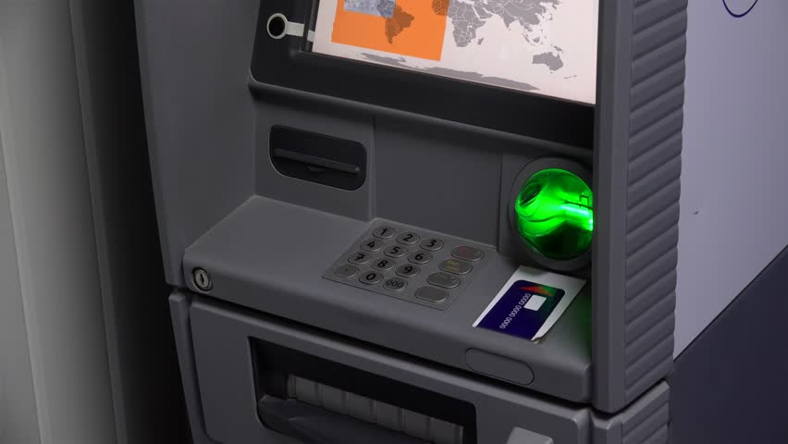
COLOR CODE AND FINGERPRINT BASED ATM SYSTEM
Submitted by:
SHIFANA .M
MCA S6
LNCE16MCA038

Slide 2
ABSTRACT
Fingerprint based ATM is a desktop application where fingerprint of the user is used as a authentication.
The fingerprint minutiae features are different for each human being so the user can be identified uniquely.
Instead of using ATM card fingerprint based ATM is safer and secure.
There is no worry of losing ATM card and no need to carry ATM card in your wallet.
You just have to use your fingerprint in order to do any banking transaction.
Color code is the alternative method for the fingerprint.

Slide 3
INTRODUCTION
The ATM is used by customer to access their bank deposit or credit accounts in order to make a variety of financial transactions by any financial institution.
ATM today use the magnetic strip or tape on the users card for identification and authentication of customer.
In the current ATM System two factor authentication is obtained where security can be breached, when password is divulged to an authorized user or card is stolen by an imposter.
To avoid this and to make more secure, adding a third level of authentication can provide significant level of strength by relying on something that the user is ie, Biometric.
Which means something about that person that cannot be changed and easily mimicked.
Biometric authentication is one of the newest exciting technical improvements of recent history and looks set to change the way in which the majority of individual live.
This is based on the fact that no two individuals can share the same morphological characteristics.

Slide 4
SYSTEM SPECIFICATION
HARDWARE REQUIRMENT
Processor : Intel Core
Hard Disk : 120GB
RAM : 2GB
Monitor : hp 15 inches
Mouse : Genius Scroll Mouse
Keyboard : 100007 keys
SOFTWARE REQUREMENT
Front End : JAVA Swing
Software Tools : Eclipse and SQLYog
Back End : MYSQL 5.0
Operating System: Windows 7/10

Slide 5
MODULES
Transaction Module
In the Transaction process the customer must choose the Authentication type like Thumb Authentication or Color code Authentication.
Next the verification panel will be displayed after verify the unique identification next step is to choose the operation type(cash deposit/cash withdrawal/balance enquiry).
Once choose the operation the cash deposit and cash withdrawal process require the amount details. After the operation success customer will get the receipt.
Transaction Report
The admin can only rights to view the daily customer transaction details.

Slide 6
Authentication Module
In the Authentication panel the customer must enter the valid mobile number for first verification step. After verified the first step customer will receive an OTP code .next step is to verify the OTP code. If valid OTP verification proceed the payment process. Next step the authentication panel choosing panel will appear. The customers can two options for the payment process.
Thumb Authentication: The customer can press their thumb in the finger print authentication device. The matching process will be started. After successful verification the customer can choose the operation type then proceed the transaction.
Color Authentication: The Customer must enter the three color code for color code authentication process.
Receipt Generation
In the ATM panel customer can get a receipt after the each successful transaction process. The receipt contains the transaction type details, amount details and balance amount details etc.

Slide 7
DFD
LEVEL 0
Transaction request using fingerprint
Color code and Fingerprint Authentication Based ATM system
Transaction Report
Customer
Administrator
Transaction slip

Slide 8
Level 1
Administrator
Handling user
Adminreg
Login
Administrator
Handling cash Transaction
Deposit,withdraw

Slide 9
User
Verification Process
Login
User
Handling Transaction

Slide 10
CONCLUSION
The implementation of ATM security by using biometric method is a crucial procedure, as well as very challenging and difficult.
Fingerprints have intrinsic features that do not change for whole life and are different individually.
They are easy to use, cheap and provide the most suitable miniaturization.
Biometric is one of the most popular and effective means for identification/verification of an individual and is used as forensic evidence.

Slide 11
FUTURE SCOPE
The system can be extended using a GSM module.
The GSM module sends alert messages to the respective authorities when unauthorized person’s finger print is detected.
Securing fingerprint based biometric system.
Performance can be improved in terms of speed and memory.
A speaking voice alarm can be used to indicate unauthorized person accessing the ATM.
System can be made to communicate with modems or mobile phones.

Slide 12
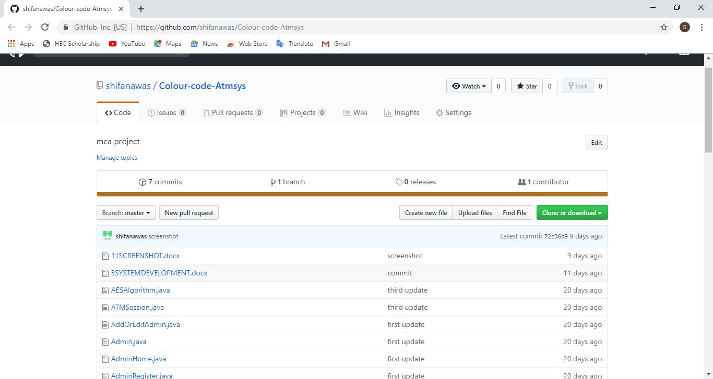
GIT LOG

Slide 13
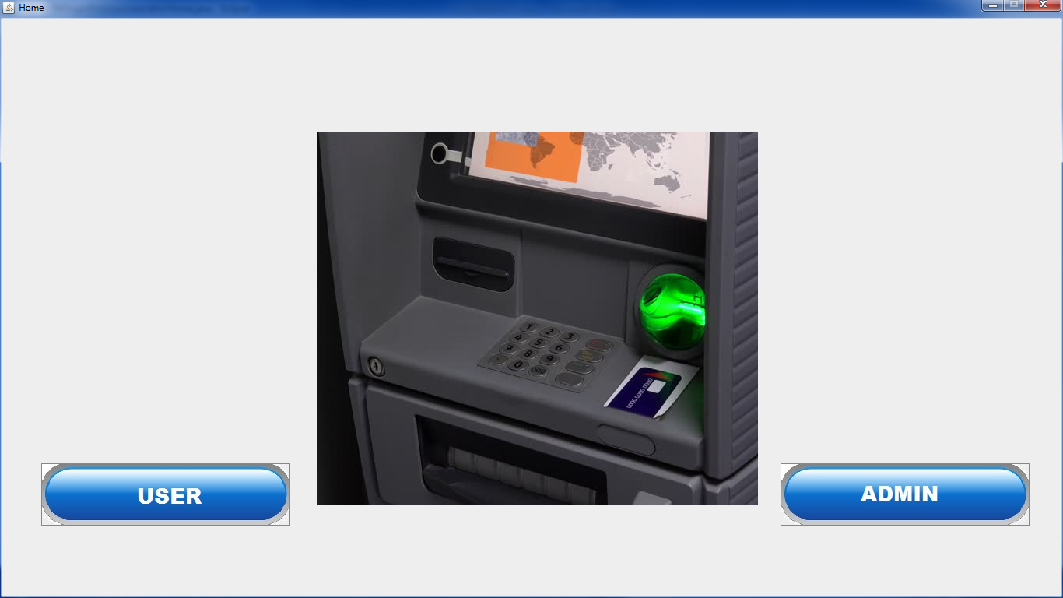
SCREEN SHOT

Slide 14
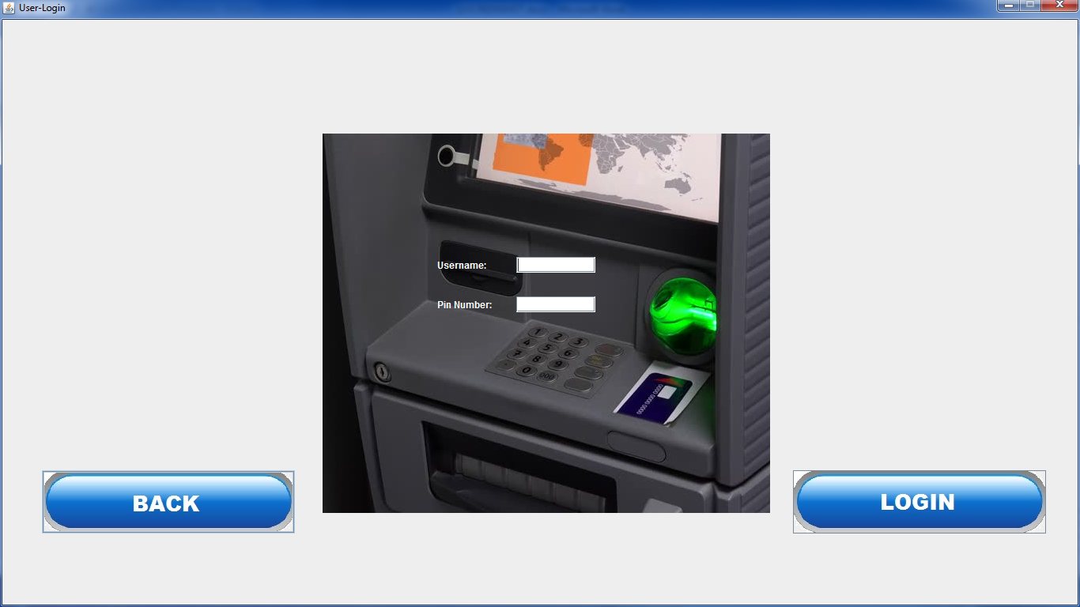

Slide 15
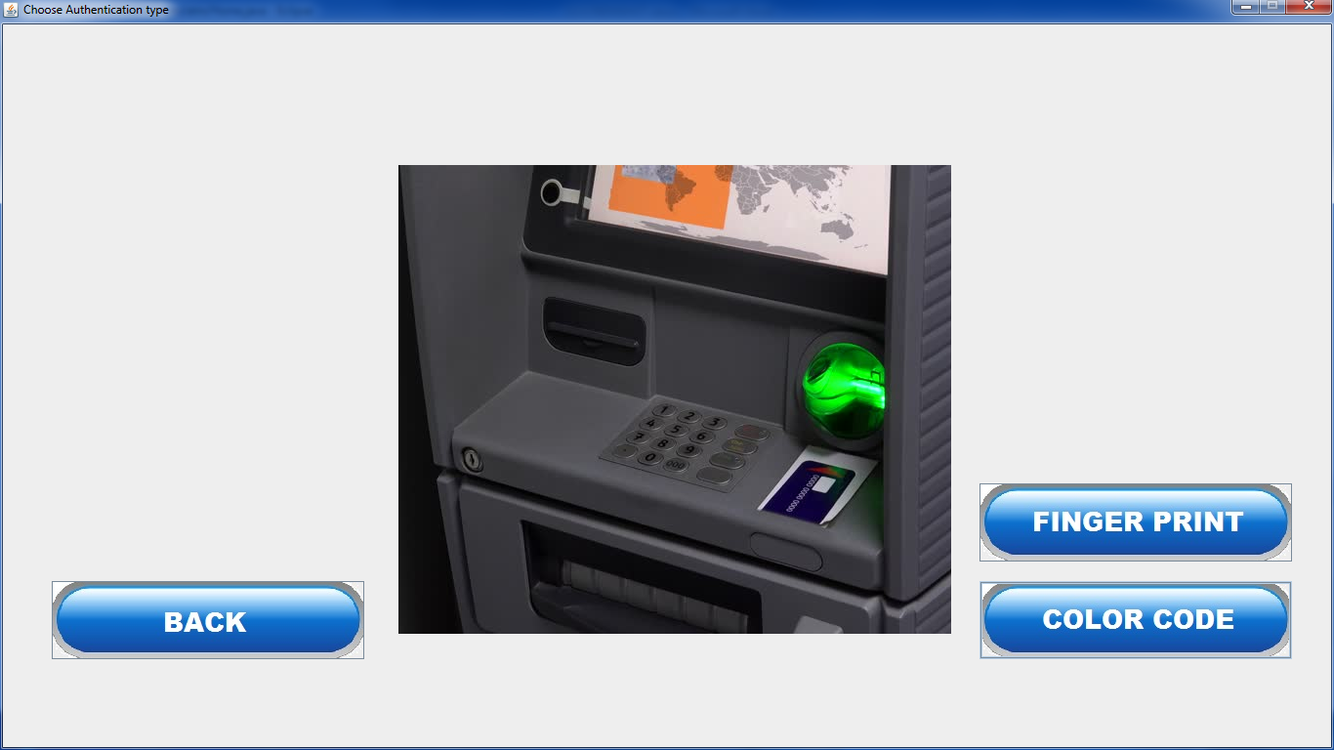

Slide 16
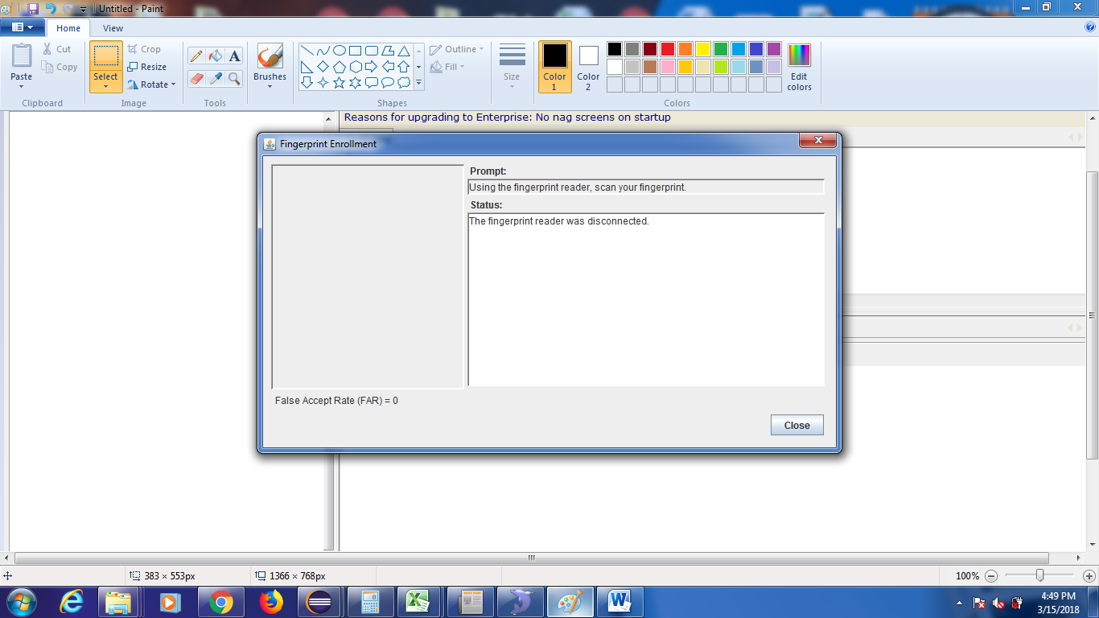

Slide 17
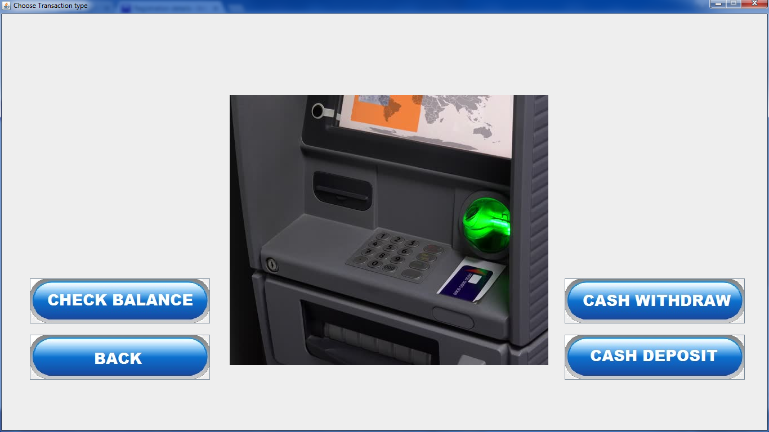

Slide 18
THANK YOU

